Slide 1
DATA WRANGLING

Slide 2
UNIT - 1
INTRODUCTION TO DATA WRANGLING

Slide 3
INTRODUCTION
Data Wrangling is referred to as data munging. It is the process of transforming and mapping data from one "raw" data form into another format to make it more appropriate and valuable for various downstream purposes such as analytics. The goal of data wrangling is to assure quality and useful data. Data analysts typically spend the majority of their time in the process of data wrangling compared to the actual analysis of the data.

Slide 4
The process of data wrangling may include further munging, data visualization, data aggregation, training a statistical model, and many other potential uses. Data wrangling typically follows a set of general steps, which begin with extracting the raw data from the data source, "munging" the raw data (e.g., sorting) or parsing the data into predefined data structures, and finally depositing the resulting content into a data sink for storage and future use.

Slide 5
Video link
https://youtu.be/sJjzrRN7voE?si=Z2B6SR3cB1rpPYLe

Slide 6
Importance of Data Wrangling
Data wrangling software has become an indispensable part of data processing. The primary importance of using data wrangling tools can be described as follows:
Making raw data usable. Accurately wrangled data guarantees that quality data is entered into the downstream analysis.
Getting all data from various sources into a centralized location so it can be used.
Piecing together raw data according to the required format and understanding the business context of data.

Slide 7
Automated data integration tools are used as data wrangling techniques that clean and convert source data into a standard format that can be used repeatedly according to end requirements. Businesses use this standardized data to perform crucial, cross-data set analytics.
Cleansing the data from the noise or flawed, missing elements.
Data wrangling acts as a preparation stage for the data mining process, which involves gathering data and making sense of it.
Helping business users make concrete, timely decisions.

Slide 8
The Data Wrangling Process
Data wrangling involves several key steps:
Data Collection: Gathering data from various sources, such as databases, spreadsheets, and APIs.
Data Cleaning: Identifying and addressing missing values, duplicates, and inconsistencies.
Data Transformation: Restructuring data, encoding categorical variables, and normalizing data.
Data Enrichment: Adding additional relevant data or features to enhance analysis.
Data Validation: Ensuring data quality and consistency before proceeding with analysis.

Slide 9
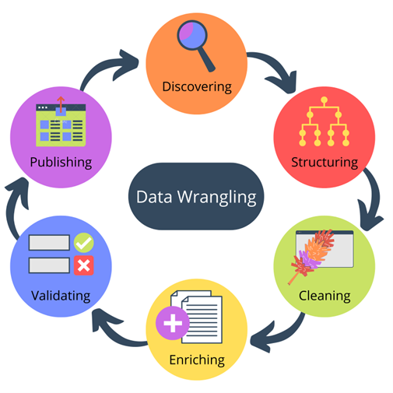

Slide 10
Common Data Wrangling Challenges
Data Inconsistency
Missing Data
Duplicate Records
Data Integration
Scalability

Slide 11
1. Data Inconsistency: Data inconsistency is one of the most common issues faced during data wrangling. This occurs when data from different sources or even within the same source varies in format, structure, or meaning. For instance, dates might be formatted differently, or addresses might follow different conventions.
2. Missing Data: Missing data can severely impact the quality of analysis. It can arise from various sources, including incomplete data entry, system errors, or data corruption. Handling missing data appropriately is crucial to ensure the accuracy of any subsequent analysis.

Slide 12
Duplicate Records: Duplicate records can skew analysis results, leading to inaccurate insights and decisions. Identifying and eliminating duplicates is a key step in the data wrangling process.
Data Integration: Integrating data from multiple sources into a single cohesive data set can be complex. Each source may have its own schema, format, and conventions, making it challenging to merge the data without losing valuable information.
Scalability: As datasets grow larger, the process of data wrangling becomes more time-consuming and resource-intensive. Efficiently wrangling large datasets requires robust tools and processes that can scale accordingly.

Slide 13
Data Acquisition
There are four methods of acquiring data:
Collecting new data;
Converting/transforming legacy data; Sharing/exchanging data;
Purchasing data.
This includes automated collection (e.g., of sensor-derived data), the manual recording of empirical observations, and obtaining existing data from other sources.

Slide 14
Web Scraping
Web Scraping is a technique to extract a large amount of data from several websites. The term "scraping" refers to obtaining the information from another source (webpages) and saving it into a local file.
For example: Suppose you are working on a project called "Phone comparing website," where you require the price of mobile phones, ratings, and model names to make comparisons between the different mobile phones. If you collect these details by checking various sites, it will take much time.
In that case, web scrapping plays an important role where by writing a few lines of code you can get the desired results.

Slide 15
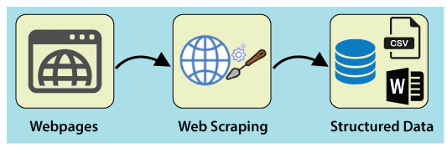
Web Scrapping extracts the data from websites in the unstructured format. It helps to collect these unstructured data and convert it in a structured form.
Startups prefer web scrapping because it is a cheap and effective way to get a large amount of data without any partnership with the data selling company.

Slide 16
Accessing Databases
Accessing databases in data acquisition techniques involves retrieving, processing, and managing data stored in various database systems. This process is essential for gathering and analyzing data to inform decision-making, research, and other applications.
Here’s an overview of the key concepts and techniques involved:

Slide 17
Understanding Databases
Types of Databases:
Relational Databases: Organize data into tables (e.g., MySQL, PostgreSQL, Oracle). Data is accessed using Structured Query Language (SQL).
NoSQL Databases: Use various data models (e.g., document-based like MongoDB, key-value stores like Redis, graph databases like Neo4j). They provide flexibility for handling unstructured or semi-structured data.
Data Warehouses: Optimized for analytical queries, integrating data from multiple sources (e.g., Amazon Redshift, Google BigQuery).

Slide 18
Connection to Databases
Database Drivers: Software components that enable applications to connect to a database. Common drivers include JDBC for Java applications and ODBC for various programming languages.
Connection Strings: Strings containing information about the data source, including the database type, server address, database name, user credentials, and any required options (e.g., timeout settings).

Slide 19
Data Retrieval Techniques
SQL Queries: Used in relational databases to fetch, insert, update, and delete data. Basic operations include:
SELECT: Retrieve specific columns from tables.
JOIN: Combine rows from two or more tables based on related columns.
WHERE: Filter results based on specific conditions.
API Access: Many modern applications provide RESTful or GraphQL APIs to access data programmatically. This is common in NoSQL databases and cloud services.
ORM (Object-Relational Mapping): Tools (like SQLAlchemy for Python or Entity Framework for .NET) that allow developers to interact with the database using high-level programming languages instead of writing raw SQL.

Slide 20
Data Processing and Management
ETL (Extract, Transform, Load): A process that involves extracting data from various sources, transforming it into a suitable format, and loading it into a destination database or data warehouse.
Data Cleaning: Ensuring that the data is accurate, complete, and free from duplicates or inconsistencies.
Data Aggregation: Summarizing data to provide insights, often used in analytics. Techniques include grouping data and performing calculations (e.g., averages, counts).

Slide 21
Data Security and Compliance
Authentication and Authorization: Ensuring that only authorized users can access and manipulate data. This can involve user roles, permissions, and secure connection protocols.
Data Encryption: Protecting sensitive data both in transit (while being transmitted) and at rest (when stored).
Compliance: Adhering to regulations regarding data privacy and protection (e.g., GDPR, HIPAA), which often dictate how data must be accessed and managed.

Slide 22
Tools and Technologies
Database Management Systems (DBMS): Software that provides tools for creating, managing, and interacting with databases (e.g., MySQL, MongoDB, Microsoft SQL Server).
Data Visualization Tools: Applications that help visualize data (e.g., Tableau, Power BI) often require database connections to retrieve the necessary data.
Scripting and Automation: Using scripts (Python, R, etc.) to automate data retrieval and processing tasks, enabling more efficient data acquisition.

Slide 23
File input/output (I/O)
File input/output (I/O) in data acquisition techniques involves the processes of reading data from and writing data to files. This is essential for collecting, storing, and managing data in various formats.
Here’s a brief overview:
File Formats
Text Files: Common formats like CSV and TXT for storing readable data.
Binary Files: Compact, non-readable formats that store data efficiently (e.g., images).
Structured Formats: JSON and XML for hierarchical data representation, often used for data interchange.
Excel Files: Widely used in business settings for data manipulation.

Slide 24
File Input Techniques
Reading Data: Involves opening a file and loading its contents for processing.
Line-by-Line Reading: Efficient for large files to minimize memory usage.
Buffered Reading: Reads chunks of data at a time for better performance.
Libraries: Tools like Pandas (Python) simplify reading complex formats.

Slide 25
File Output Techniques
Writing Data: Saving processed data to files.
Appending Data: Adding new information without overwriting existing data.
Creating New Files: Saving data in the same or different formats.
Exporting Data: Converting data to formats for use in other applications.

Slide 26
Data Processing Steps
Parsing: Transforming raw file data into a structured format.
Transformation: Cleaning and modifying data before writing it to a file.
Validation: Ensuring data integrity before processing.
Error Handling and Performance
Error Handling: Managing potential I/O errors (e.g., file not found) using exception handling.
Performance: Considerations include file size and I/O speed. Techniques like streaming and chunking can optimize performance for large datasets.

Slide 27
Use Cases
Data Collection: Gathering data from sources (e.g., sensors) and saving it for analysis.
Data Sharing: Exporting data for sharing with stakeholders.
Backup and Archiving: Saving data to prevent loss.
File I/O is a critical aspect of data acquisition that enables efficient data management through various formats and techniques, facilitating the analysis and sharing of information.

Slide 28
Exploratory Data Analysis (EDA)
Exploratory Data Analysis (EDA) is a critical step in the data analysis process that involves examining and visualizing datasets to understand their underlying structures and characteristics. EDA is particularly useful for identifying data quality issues, which can significantly impact the accuracy and reliability of any subsequent analysis.
Here’s a detailed explanation of EDA, focusing on its role in understanding data quality issues:

Slide 29
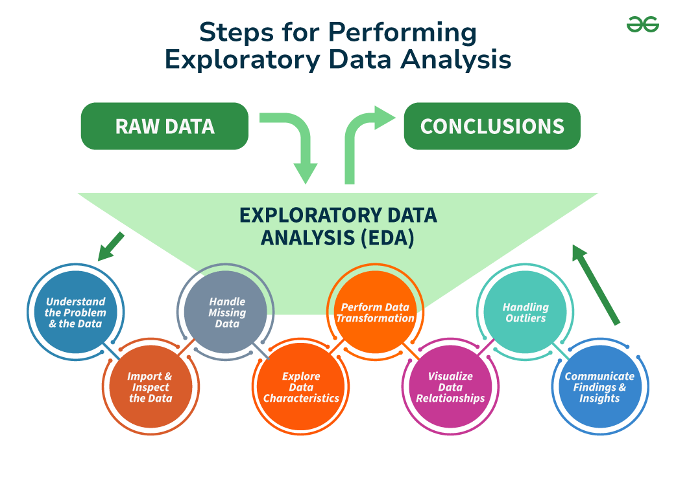

Slide 30
Purpose of EDA
Understand Data: Gain insights into the structure, patterns, and relationships within the data.
Identify Quality Issues: Detect problems such as missing values, outliers, and inconsistencies.
Key Components of EDA
Summary Statistics: Calculating measures like mean, median, mode, and standard deviation to understand central tendencies and variability.
Data Visualization: Creating graphs and plots (like histograms, box plots, and scatter plots) to visualize distributions and relationships in the data.

Slide 31
Identifying Data Quality Issues
Missing Values: Checking for and analyzing gaps in data, which can affect analysis.
Outliers: Identifying unusual data points that may skew results.
Data Types: Ensuring that data types are correct (e.g., numbers stored as strings), which can lead to analysis errors.
Duplicates: Finding and addressing repeated entries that can distort results.

Slide 32
Techniques Used in EDA
Histograms: Visualizing the distribution of numerical data to identify patterns or anomalies.
Box Plots: Detecting outliers and understanding data spread.
Scatter Plots: Exploring relationships between two variables.
Correlation Matrices: Assessing how variables are related to each other.

Slide 33
Benefits of EDA
Informed Decisions: Understanding data quality allows for better decision-making in data cleaning and preprocessing.
Enhanced Analysis: Identifying issues early helps improve the accuracy and reliability of subsequent analyses.
In summary, EDA is a crucial step in the data analysis process that helps identify and understand data quality issues, ensuring the integrity and reliability of the data before conducting further analyses or drawing conclusions.

Slide 34
Data cleaning techniques:
Data cleansing or data cleaning is the process of detecting and correcting (or removing) corrupt or inaccurate records from a record set, table, or database and refers to identifying incomplete, incorrect, inaccurate or irrelevant parts of the data and then replacing, modifying, or deleting the dirty or coarse data.
Data cleansing may be performed interactively with data wrangling tools, or as batch processing through scripting.

Slide 35
After cleansing, a data set should be consistent with other similar data sets in the system. The inconsistencies detected or removed may have been originally caused by user entry errors, by corruption in transmission or storage, or by different data dictionary definitions of similar entities in different stores.
Data cleaning differs from data validation in that validation almost invariably means data is rejected from the system at entry and is performed at the time of entry, rather than on batches of data.
Here are some common data cleaning techniques explained in simple terms, along with examples for better understanding:

Slide 36
Handling Missing Values
What It Is: Missing values are gaps in your data where information is not available.
Techniques:
Removal: You can delete rows or columns with missing values if they are not too many.
Example: If you have a dataset of 1,000 entries and only 5 have missing ages, you might choose to remove those 5 rows.
Imputation: Fill in the missing values with reasonable estimates.
Example: If the average age in a dataset is 30 and one entry is missing age, you could fill that in with 30 (mean imputation).

Slide 37
Removing Duplicates
What It Is: Sometimes, the same entry can appear more than once in a dataset.
Technique:
Identifying and Dropping Duplicates: Find and remove these duplicate entries.
Example: If your dataset contains two identical entries for a customer, you would keep one and remove the other to ensure each customer is counted only once.

Slide 38
Standardizing Data Formats
What It Is: Ensuring that all data entries follow a consistent format.
Techniques:
Consistent Formatting: Make sure all data is in the same style.
Example: If you have dates in different formats (e.g., "MM/DD/YYYY" and "YYYY-MM-DD"), you can convert them all to "YYYY-MM-DD" for uniformity.

Slide 39
Correcting Inconsistencies
What It Is: Fixing errors or variations in data entries.
Technique:
Typographical Errors: Correct common misspellings or variations in names.
Example: If "USA" and "United States" are used interchangeably, choose one term and change all instances to that term for consistency.

Slide 40
Removing Outliers
What It Is: Outliers are data points that are much higher or lower than the rest of the data and can skew results.
Technique:
Identifying Outliers: Use statistical methods to find them.
Example: If most ages in your dataset range from 20 to 60, but one entry is 200, that entry is an outlier. You might choose to investigate or remove it.

Slide 41
Data Validation
What It Is: Ensuring that the data follows certain rules.
Techniques:
Range Checks: Check if data falls within expected limits.
Example: If you have a field for “age,” you can ensure that no ages are negative or unrealistically high (like 150 years).

Slide 42
Data Transformation
What It Is: Changing data into a different format or structure.
Techniques:
Binning: Grouping continuous data into categories.
Example: If you have ages ranging from 1 to 100, you could create bins like "0-18", "19-35", "36-50", etc., to simplify analysis.

Slide 43
Data Integration
What It Is: Combining data from multiple sources while keeping it clean.
Techniques:
Combining Datasets: When you merge datasets, make sure to eliminate duplicates and resolve conflicts.
Example: If you have one dataset with customer information and another with their orders, you would merge them and remove any duplicate customer entries.

Slide 44
Documentation and Audit Trails
What It Is: Keeping a record of all cleaning steps taken.
Technique:
Documenting Changes: Write down what changes were made and why.
Example: If you removed certain duplicates, you might note in your records that "Removed duplicate entries for customer ID 123."

Slide 45
Data cleaning techniques are vital for preparing your data for analysis. By handling missing values, removing duplicates, standardizing formats, correcting inconsistencies, and more, you can ensure your data is accurate and reliable. This leads to better insights and decisions based on the data.

Slide 46
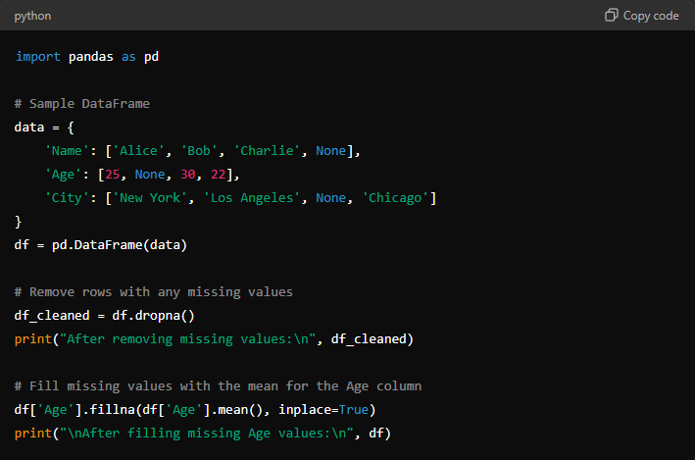
Handling Missing Values
Example:

Slide 47
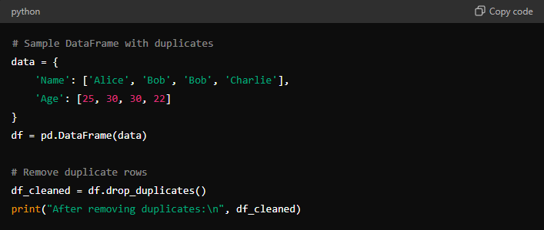
Removing Duplicates
Example:

Slide 48
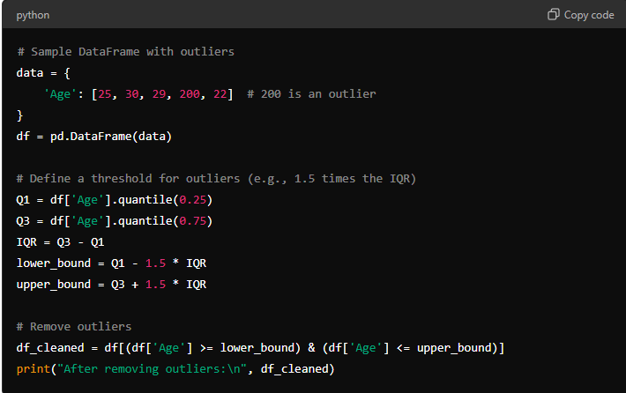
Removing Outliers
Example:

